Slide 1
Future Interaction Prediction between Proteins using PPI Graph
Risul Islam

Slide 2
Problem Definition
Input: PPI graph
Output: Predict whether there will have interaction between two proteins
protein1
Protein 3
0.05
0.8
Protein 2
Protein 4

Slide 3
Roadmap
PPI Graph
Dataset
Comparison between Human and Mouse PPI graph based on distances
Different distance measurements
Link prediction metrics
Results
Discussion
References

Slide 4
PPI Graph
Nodes are proteins
Undirected edges
Edge (u,v) if u and v are known to interact (bind, dock etc)
protein1
Protein 3
Protein 2
Protein 4

Slide 5
Dataset
We have compared two PPI graph
Human and Mouse
Kept only edges whose confidence score of interaction is above 500.
Lower scored protein pairs are kept for testing
Collected data from https://string-db.org

Slide 6
Comparison between Human and Mouse PPI graph based on distances
Measured six metrics
Degree Centrality
Betweenness Centrality
Closeness Centrality
Eigenvector Centrality
Subgraph Centrality
Maximal Clique

Slide 7
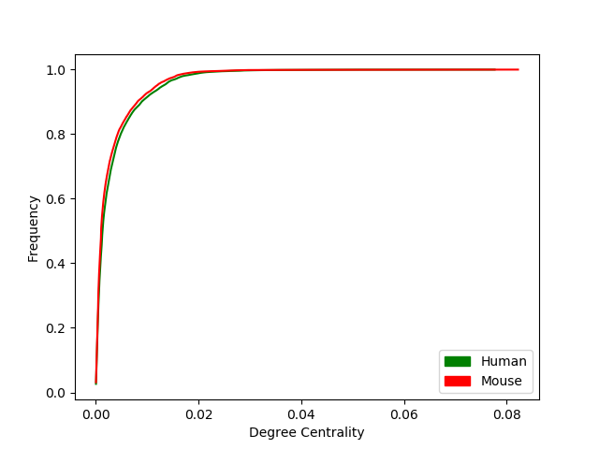
Degree Centrality
The degree centrality for a node v is the fraction of nodes it is connected to [1]
HUMAN
Avg: 84% of the nodes has DC <=0.01
Exceptional: 60% of the nodes DC<=0.0025 , 98% DC>=0.02
MOUSE
Avg: 86% of the nodes has DC <=0.01
Exceptional: 64% of the nodes DC<=0.0025 , 99.2% DC>=0.02
Degree Centrality

Slide 8
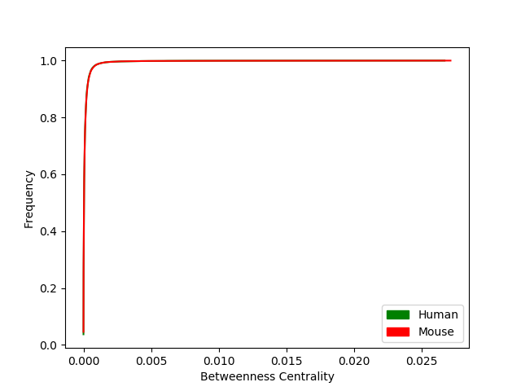
Betweenness Centrality
Betweenness centrality of a node v is the sum of the fraction of all-pairs shortest paths that pass through v [2]
HUMAN
Avg: 95% of the nodes hase BC <=0.00125
Exception: 0.5% has BC>=0.0025
MOUSE
Avg: 95% of the nodes hase BC <=0.00125
Exception: 0.5% has BC>=0.0025
Betweenness Centrality

Slide 9
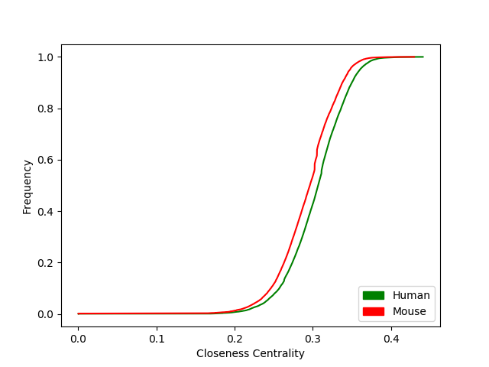
Closeness Centrality
Closeness centrality of a node u is the reciprocal of the average shortest path distance to u over all n-1 reachable nodes [3]
HUMAN
Avg: 60% of the nodes has
CC <=0.3125
Exceptional: 1% CC<=0.2,
7% CC>=0.35
MOUSE
Avg: 60% of the nodes has
CC <=0.3
Exceptional: 4% CC<=0.2,
2% CC>=0.35
Closeness Centrality

Slide 10
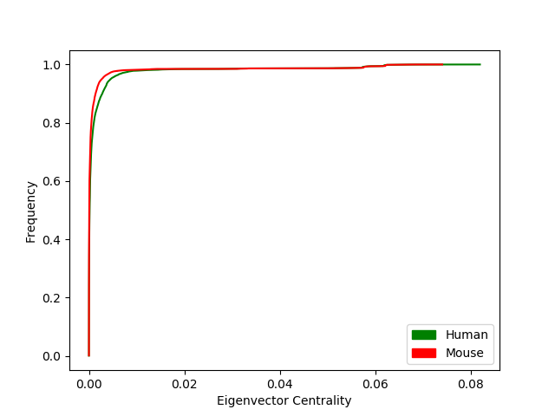
Eigenvector Centrality
Eigenvector centrality computes the centrality for a node based on the centrality of its neighbors. [4]
HUMAN
Avg: 90% of the nodes EC<=0.005
Exceptional:
3% EC>=0.01
MOUSE
Avg: 97% of the nodes EC<=0.005
Exceptional:
1% EC>=0.01
Eigenvector Centrality

Slide 11
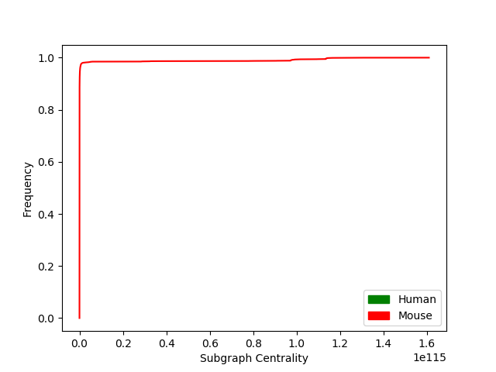
Sub graph Centrality
Subgraph centrality of a node n is the sum of weighted closed walks of all lengths starting and ending at node n [5]
HUMAN
Avg: 97% of the nodes has SC=0
Rest 3% SC >0
MOUSE
Avg: 97% of the nodes has SC=0
Rest 3% SC >0
Subgraph Centrality

Slide 12
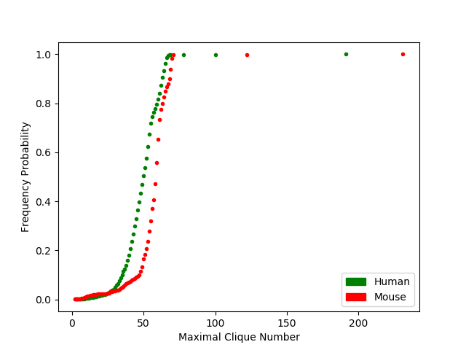
Maximal Clique
For each node v, a maximal clique for v is a largest complete subgraph containing v. The largest maximal clique is sometimes called the maximum clique
HUMAN
Avg: 80% of the cliques has <=60 nodes
Exceptional: 7% of the cliques has <=35 nodes, 2% has >=66 nodes
MOUSE
Avg: 60% of the cliques has <=60 nodes
Exceptional: 7% of the cliques has <=35 nodes, 2% has >=70 nodes
Maximal
Clique

Slide 13
Comparison between Human and Mouse PPI
Property name | Human | Mouse
Number of degree | 18915 | 19707
Number of edge | 574741 | 550330
Max degree | 1469 | 1620
Max degree protein | UBA52 (Ribosomal Protein) | Gnb1 (Guanine nucleotide-binding protein)
Median degree | 26 | 21
Avg degree | ~61 | ~56
Min degree | 1 | 1
Number of connected component | 10 | 17
Number of nodes in maximum connected component | 18895 | 19674
Number of Maximal clique | 74623 | 93254
Maximum clique number | 191 | 231
Maximum radius | 5 | 6
Maximum Diameter | 10 | 10
Number of nodes as center nodes | 24 | 2772

Slide 14
Comparison Based on Distances
Both PPI network has a big connected component.
In that sense, they work more likely a Random Network.
Number of center nodes is very low in human.
Notes:
Eccentricity: The eccentricity of a node v is the maximum distance from v to all other nodes in G.
Radius: The radius is the minimum eccentricity.
Diameter: The diameter is the maximum eccentricity.
Center: The center is the set of nodes with eccentricity equal to radius.

Slide 15
Link Prediction Metrics
We have worked with two link prediction metrics
For each edge not present in PPI graph, we have calculated these metrics scores.
If score is above a certain threshold, we can say that there is a future link between them.
Note that we have some existing edges discarded from PPI for testing.

Slide 16
Link Prediction Metrics
Jaccard similarity based metric
Resource allocation based metric
To say a future link between an edge, we have measured these two scores individually, their or and also their and.
We have found out that when we are taking the and (meaning both metrics are above the threshold) we get much more predicted links that are already been discovered

Slide 17
Jaccard Similarity based Metric
Compute the Jaccard coefficient of all node pairs in edge list. [6]
Jaccard coefficient of nodes u and v is defined as
|Γ(u)∩Γ(v)|/|Γ(u)∪Γ(v)|
where Γ(u) denotes the set of neighbors of u

Slide 18
Resource Allocation based metric
Compute the resource allocation index of all node pairs in edge list. [7]
Resource allocation index of u and v is defined as
∑w∈Γ(u)∩Γ(v) 1/|Γ(w)|
where Γ(x) denotes the set of neighbors of x

Slide 19
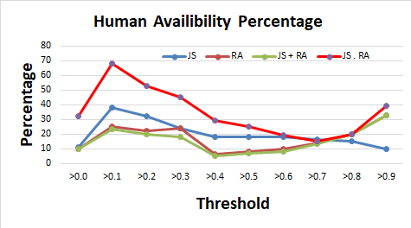
Results Human predicted links currently available in testing set

Slide 20
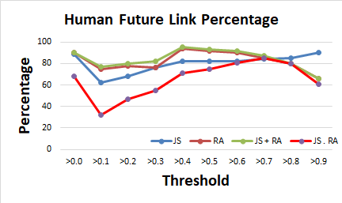
Results Human predicted links for Future

Slide 21
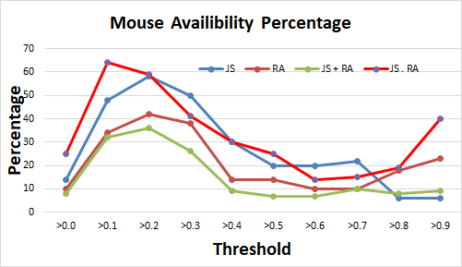
Results Mouse predicted links currently available in testing set

Slide 22
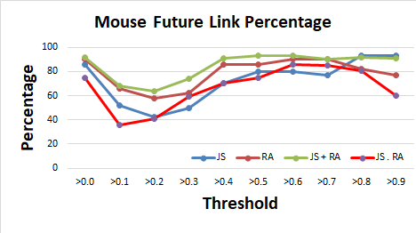
Results Mouse predicted links for Future

Slide 23
Discussion
In this project, we have compared human and mouse PPI graph
Predicted future interaction
Varified our result with currently available testing set
However, there are some limitations
1. The dataset is not divided into equal parts. That means only proteins interaction with high confidence scores were in PPI whose number is lower than available in testing set ( proteins interaction with lower confidence)
2. Should have constructed the PPI’s taking random interaction pairs
3. Finding optimal threshold is challenging. We have thus analyzed all possible combination of threshold.
4. Can be tested with other link prediction metrics

Slide 24
References
1.https://networkx.github.io/documentation/stable/reference/algorithms/generated/networkx.algorithms.centrality.degree_centrality.html#networkx.algorithms.centrality.degree_centrality
2. Ulrik Brandes and Christian Pich: Centrality Estimation in Large Networks. International Journal of Bifurcation and Chaos 17(7):2303-2318, 2007
3. : Linton C. Freeman: Centrality in networks: I. Conceptual clarification. Social Networks 1:215-239, 1979
4.https://networkx.github.io/documentation/stable/reference/algorithms/generated/networkx.algorithms.centrality.eigenvector_centrality.html#networkx.algorithms.centrality.eigenvector_centrality
5. : Ernesto Estrada, Juan A. Rodriguez-Velazquez, “Subgraph centrality in complex networks”, Physical Review E 71, 056103 (2005).
6. D. Liben-Nowell, J. Kleinberg. The Link Prediction Problem for Social Networks (2004).
7. T. Zhou, L. Lu, Y.-C. Zhang. Predicting missing links via local information. Eur. Phys. J. B 71 (2009) 623

Slide 25
Thanks

